Slide 1
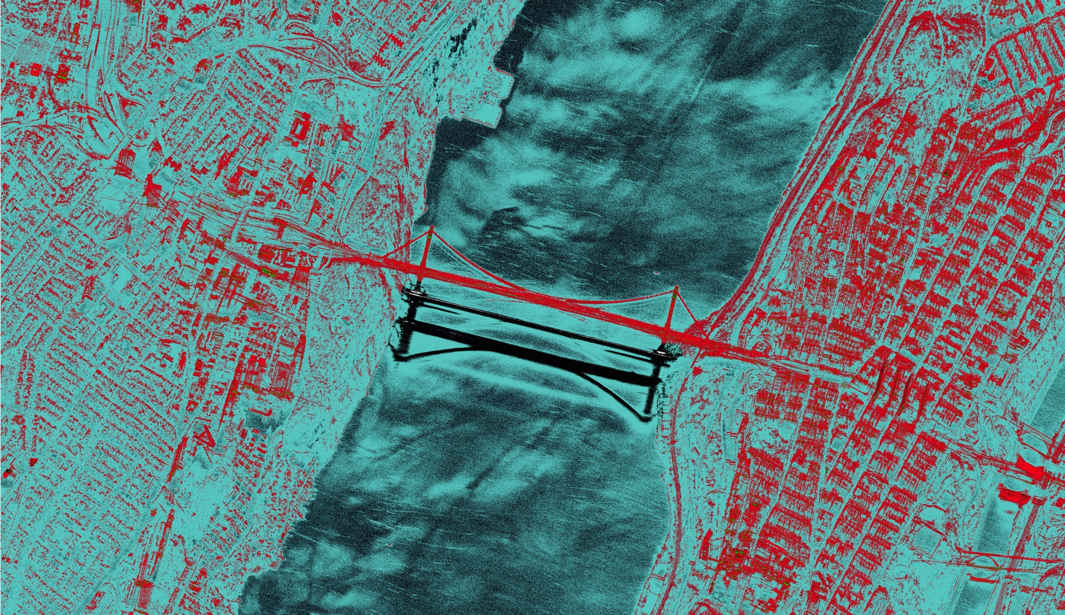

Synthetic Aperture Radar
Dr Carmine Clemente
carmine.clemente@strath.ac.uk
Original SAR image courtesy of Capella Space

Slide 2

SAR Principles
Dr Carmine Clemente
carmine.clemente@strath.ac.uk
Original SAR image courtesy of Capella Space

Slide 3
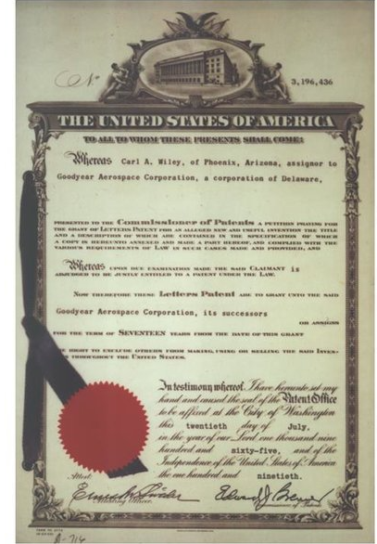
Introduction
The idea of synthesizing a large antenna from a succession of spatial sample has its origins in radio-astronomy;
The idea of a synthetic aperture radar (i.e. an active system) was conceived by Carl Wiley in the USA in the 1950s, in the context of sideways-looking airborne radar;
He recognized that the variation in Doppler shift of echoes from a target meant that the beam-width of a sideways-looking radar could be artificially reduced by filtering (Doppler beam sharpening or unfocused aperture synthesis).
This approach exploits both time of arrival and Doppler effect!

Slide 4
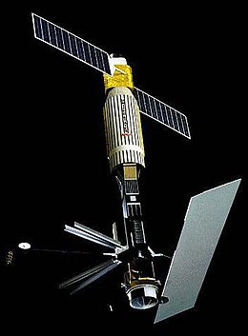
Introduction
The first space-borne SAR was carried by NASA SEASAT satellite in 1978. This only lasted for three months, but in that time it produced a wealth of data from land, ocean and ice surfaces;
Nowadays SAR includes a powerful set of techniques;
Examples are interferometry, polarimetry, inverse SAR, moving target indication, etc.

Slide 5
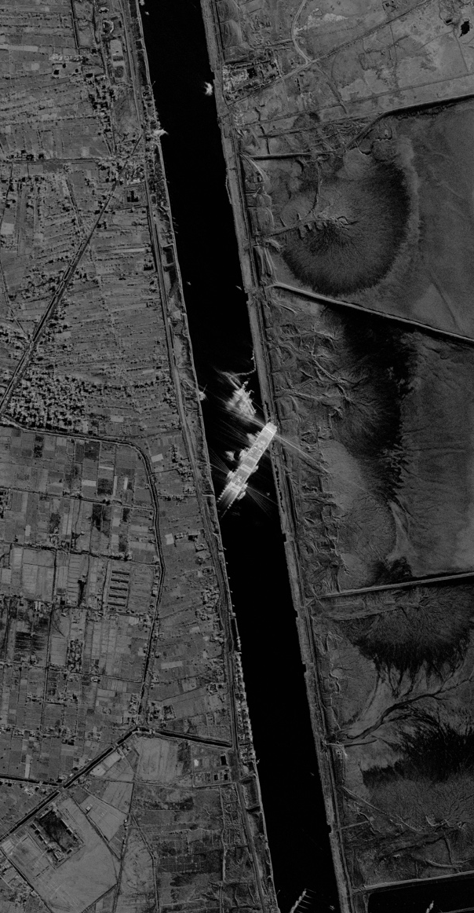
Introduction
SAR inherits the key radar advantages, such as the capability to observe in any weather and light conditions;
A fundamental aspect is that the spatial resolution does not depend on the distance from the scene (contrary to the optical sensors), but just on the geometry, synthetic antenna length and transmitted signal bandwidth;
Sensor characteristics (path/orbit and RF components), acquisition mode, waveform, swath, amount of data generated and polarimetric capabilities are some of the aspects to be considered when designing a SAR system.
Evergreen Obstructing Suez Channel
© 2023 Capella Space.

Slide 6
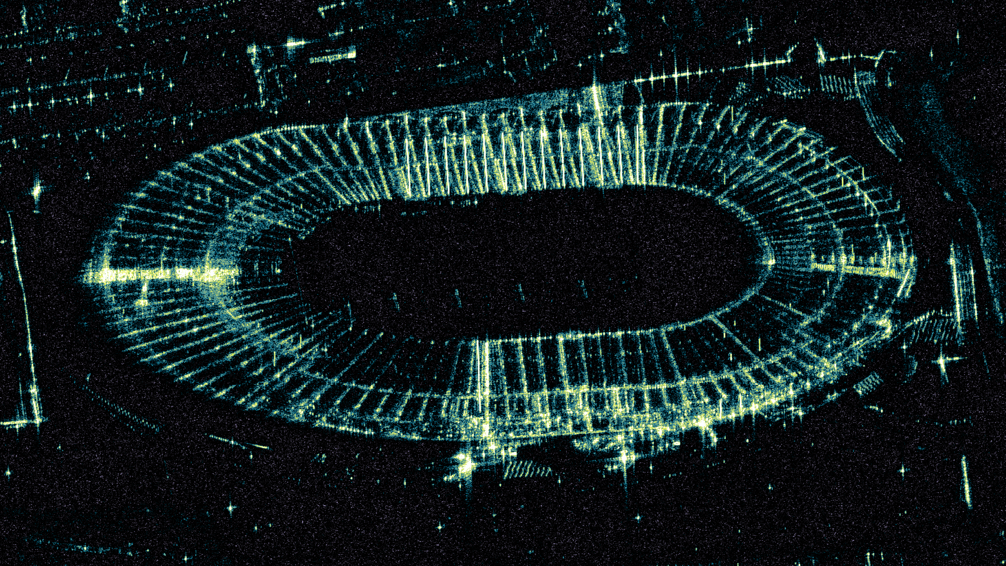
Hampden park 14/03/2024
Courtesy of Umbra.

Slide 7
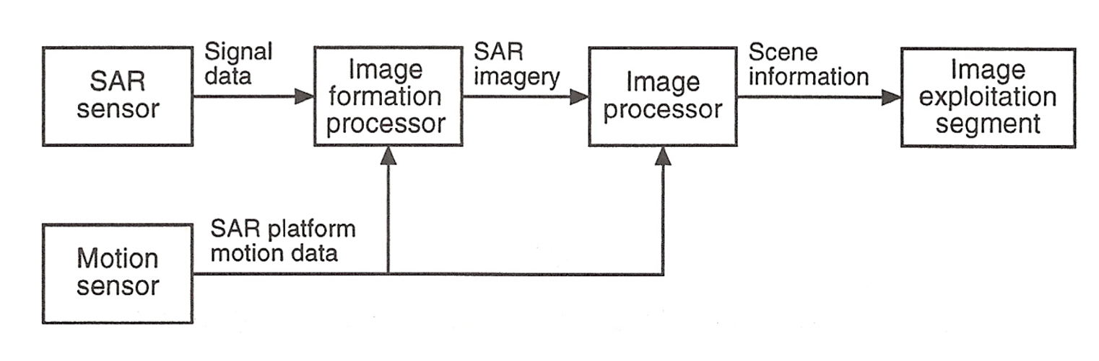
System Overview
The data collected by the sensor are processed to form an image by combining the data with platform motion information;
From the image further corrections are applied and information can be extracted, such as target detection, recognition, scene characterization;
The retrieved information can be then exploited for the downstream applications (environmental, civil, maritime, defence, etc.).

Slide 8
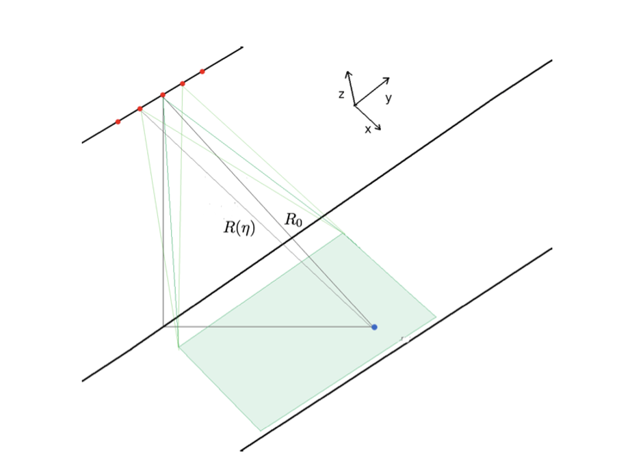
Working principle
The radar illuminates the scene with a train of pulses separated by a desired PRI;
The platform moves along a trajectory (most of the times linear, but can be also circular);
As the platforms moves it acquires multiple returns from the scene;
Let’s consider a single point target, the distance between the platform and the point target is a function of the slow time;

Slide 9

Working principle
Azimuth – Slow time
Range – Fast Time

Slide 10
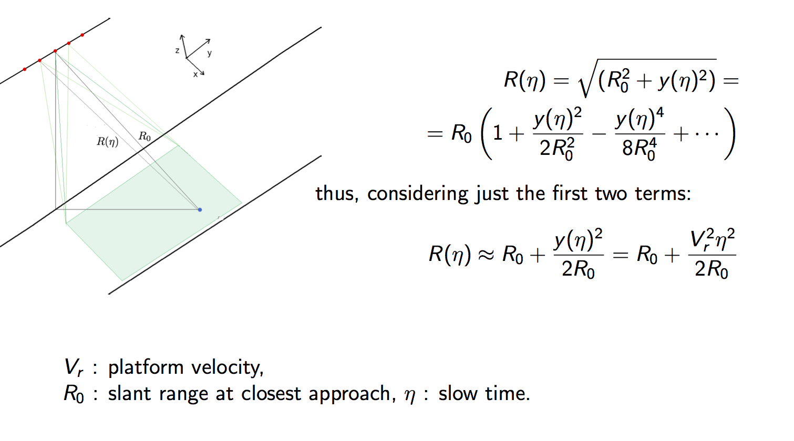
SAR Geometry

Slide 11
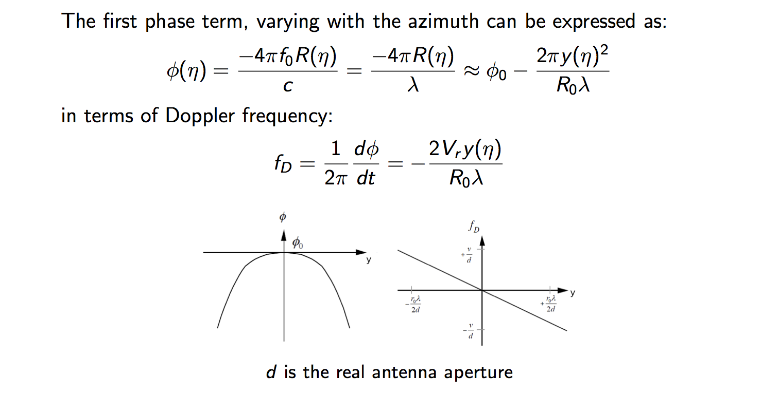
Azimuth behaviour
The Doppler introduces a linear Frequency Modulation in Azimuth

Slide 12
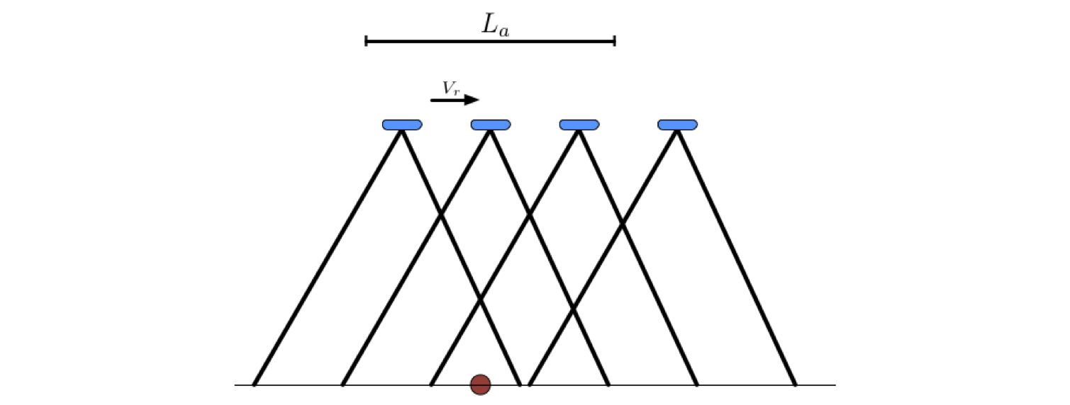
Synthetic Antenna Length
The Synthetic Antenna Length is the space travelled by the sensor while the target is in its footprint.

Slide 13
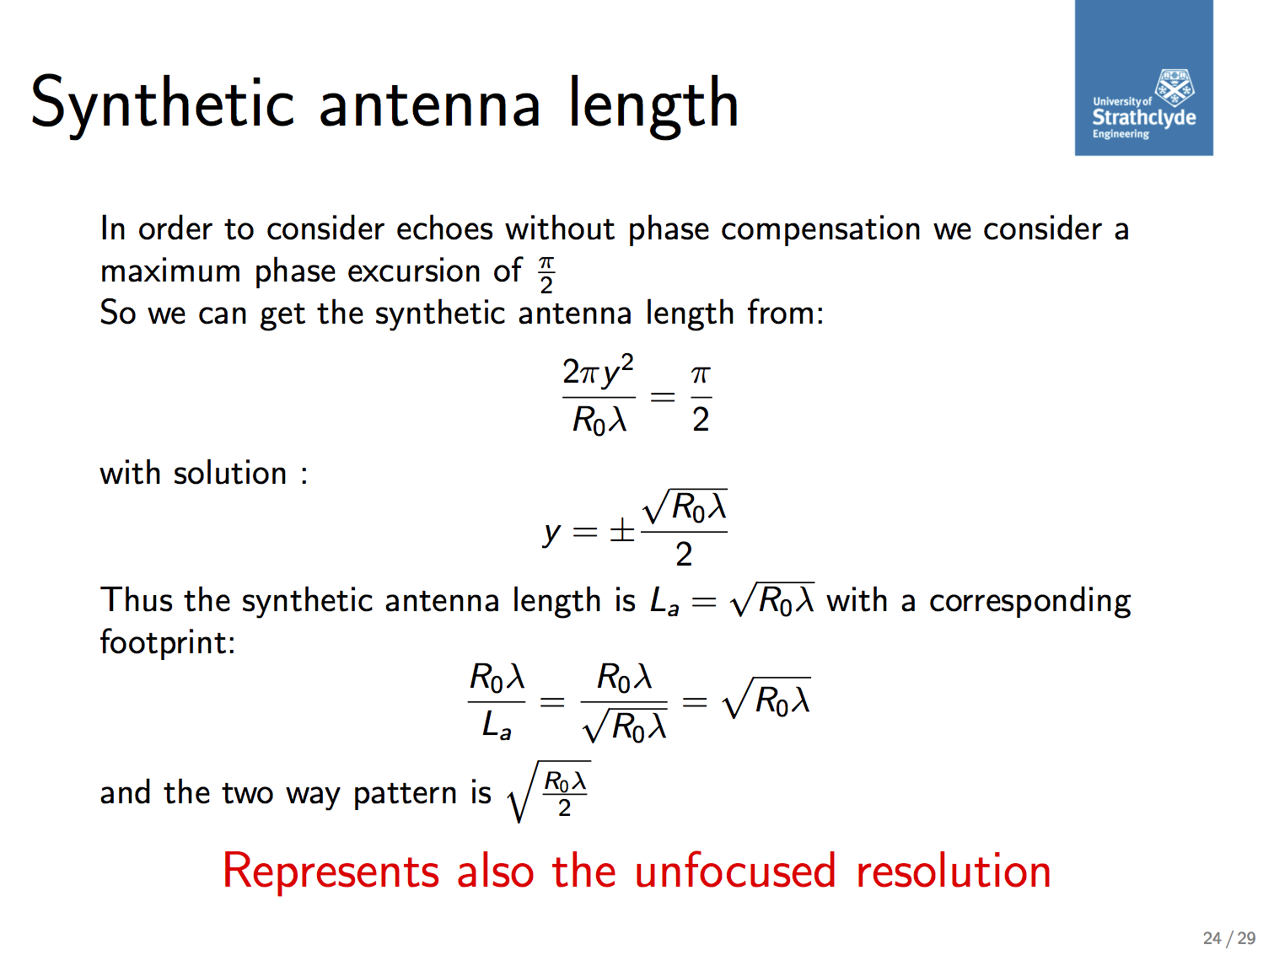
Synthetic Antenna Length

Slide 14
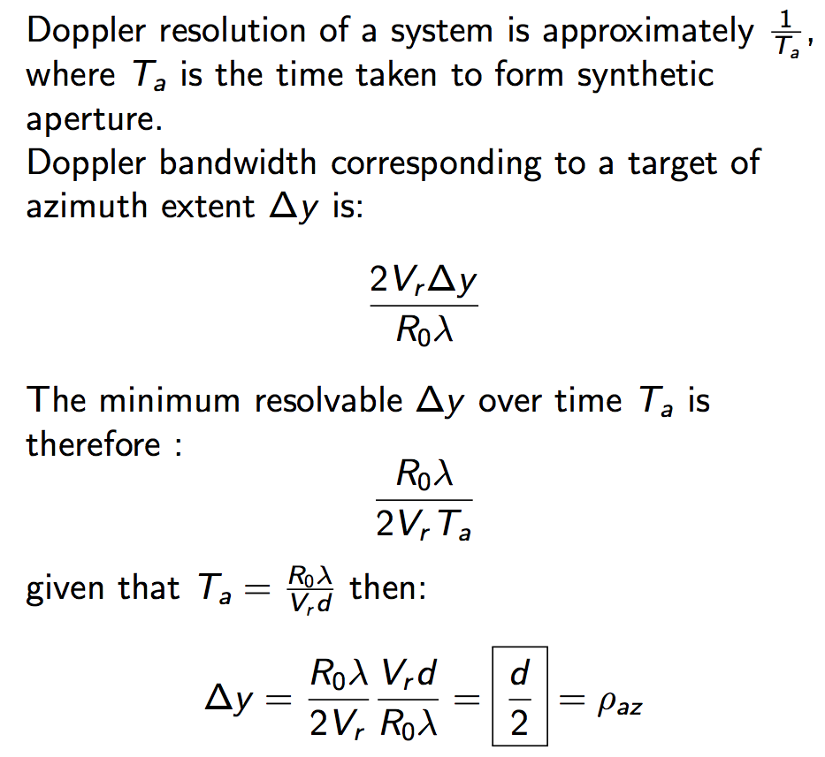
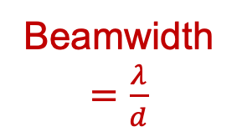
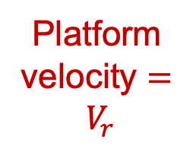
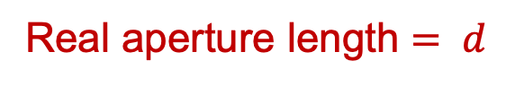
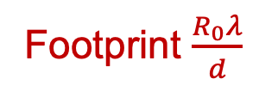
Azimuth Resolution
Real aperture length $= d$
Platform velocity $= V_{r}$
Beamwidth$=\frac{λ}{d}$
Footprint $\frac{R_{0}λ}{d}$

Slide 15
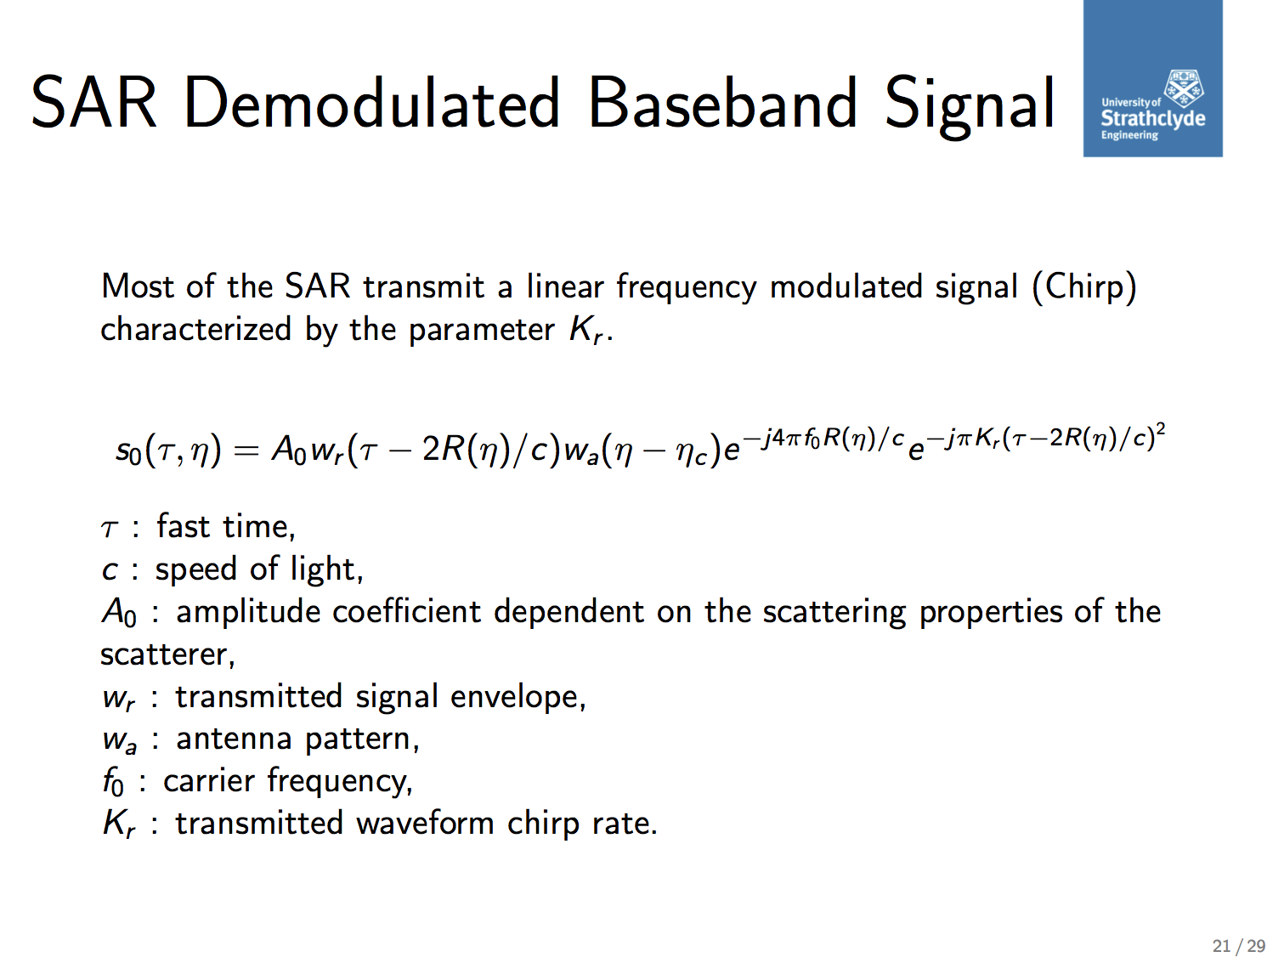
SAR Demodulated Baseband Signal
In most of the cases a SAR transmits a linear frequency modulated signal (chirp) characterized by the parameter $K_{r}$

Slide 16
Ambiguities and PRF Selection
As seen for the generic radar case, also SAR design should cope with the maximum unambiguous range;
In addition as it necessarily requires to handle a certain Doppler bandwidth the PRF must be designed so that it can handle that too;
The PRF must be selected so that it gives us unambiguous azimuth and a reasonable unambiguous range at the same time!

Slide 17
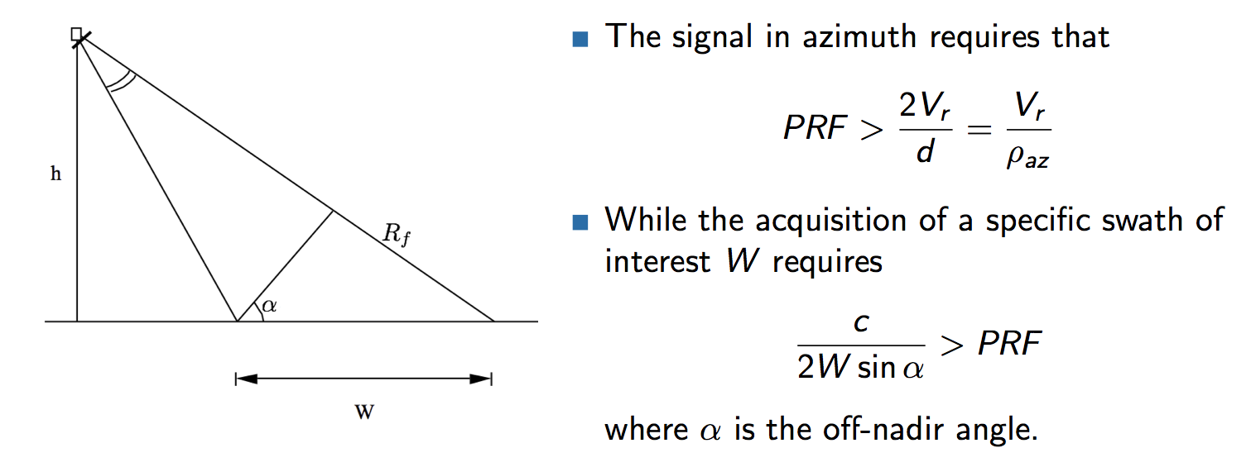
Ambiguities and PRF Selection
Azimuth ambiguity - Sufficient sampling
Range Ambiguity
Sufficient time spacing between samples

Slide 18
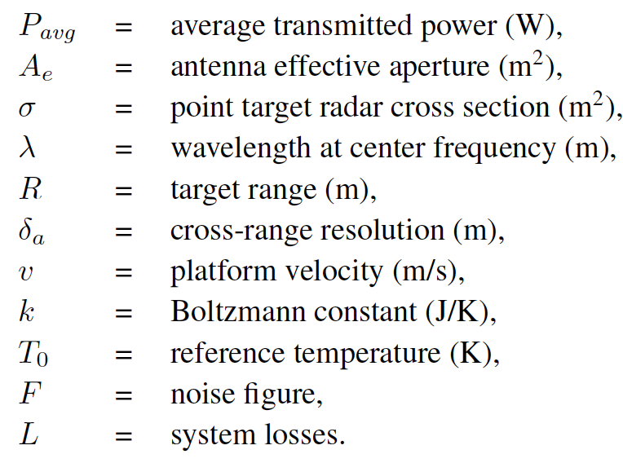
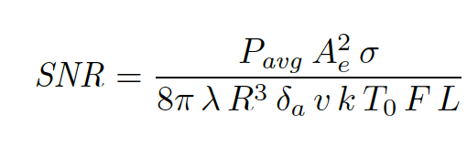
SAR Equation
The signal-to-noise ratio (SNR) for a single point scatterer in a SAR scene may be
written in terms of the cross-range resolution:
For distributed targets, such as clutter, the radar cross section may be written in terms of the range and cross-range resolutions as

Slide 19
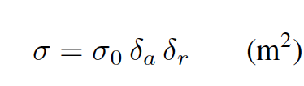
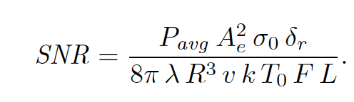
SAR Equation
For distributed targets, such as clutter, the radar cross section may be written in terms of the range and cross-range resolutions as

Slide 20
SAR Equation
This is also known as the clutter-to-noise ratio (CNR) when the distributed target is clutter.
The SNR for point targets increases with finer crossrange resolution and is independent of range resolution.
The SNR for distributed targets decreases with finer range resolution and is independent of cross-range resolution.
In general, an SNR greater than 3 dB is required for acceptable imagery products.

Slide 21
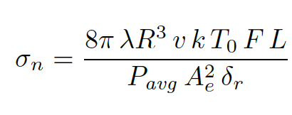
Noise Equivalent Sigma Zero
A more typical quality figure used to assess the sensitivity of a SAR sensor is called Noise Equivalent Sigma Zero;
It measures the Backscattering Coefficient that gives us a 0 dB SNR value, or SNR =1;
This parameter gives an indication of the noise floor of an image. All received signals must be stronger than the NESZ value to rise above the noise level.
Ideally, the NESZ for a SAR system will be a small value and images with high NESZ values will appear grainy.
Typical values of NESZ for spaceborne SAR systems are in the -15 to -25 dB range.

Slide 22
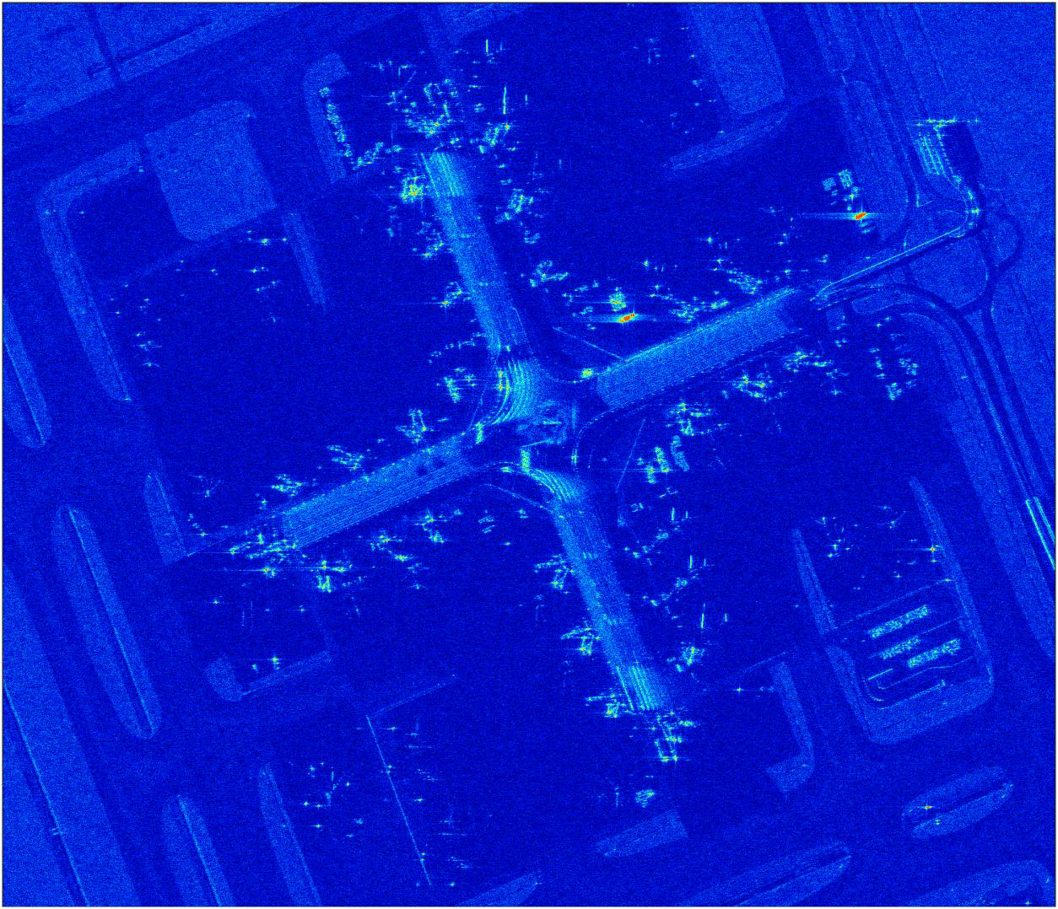
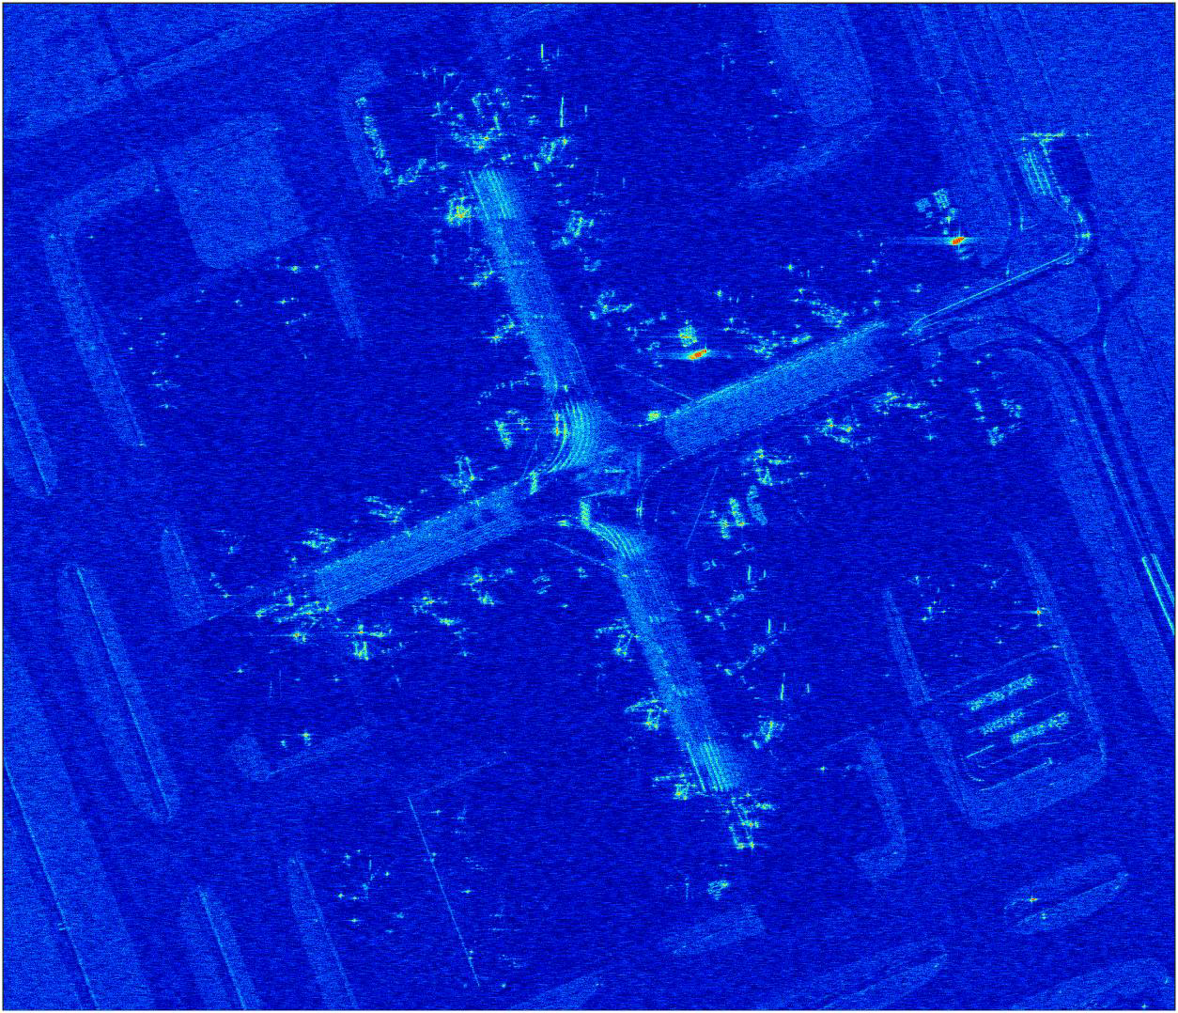
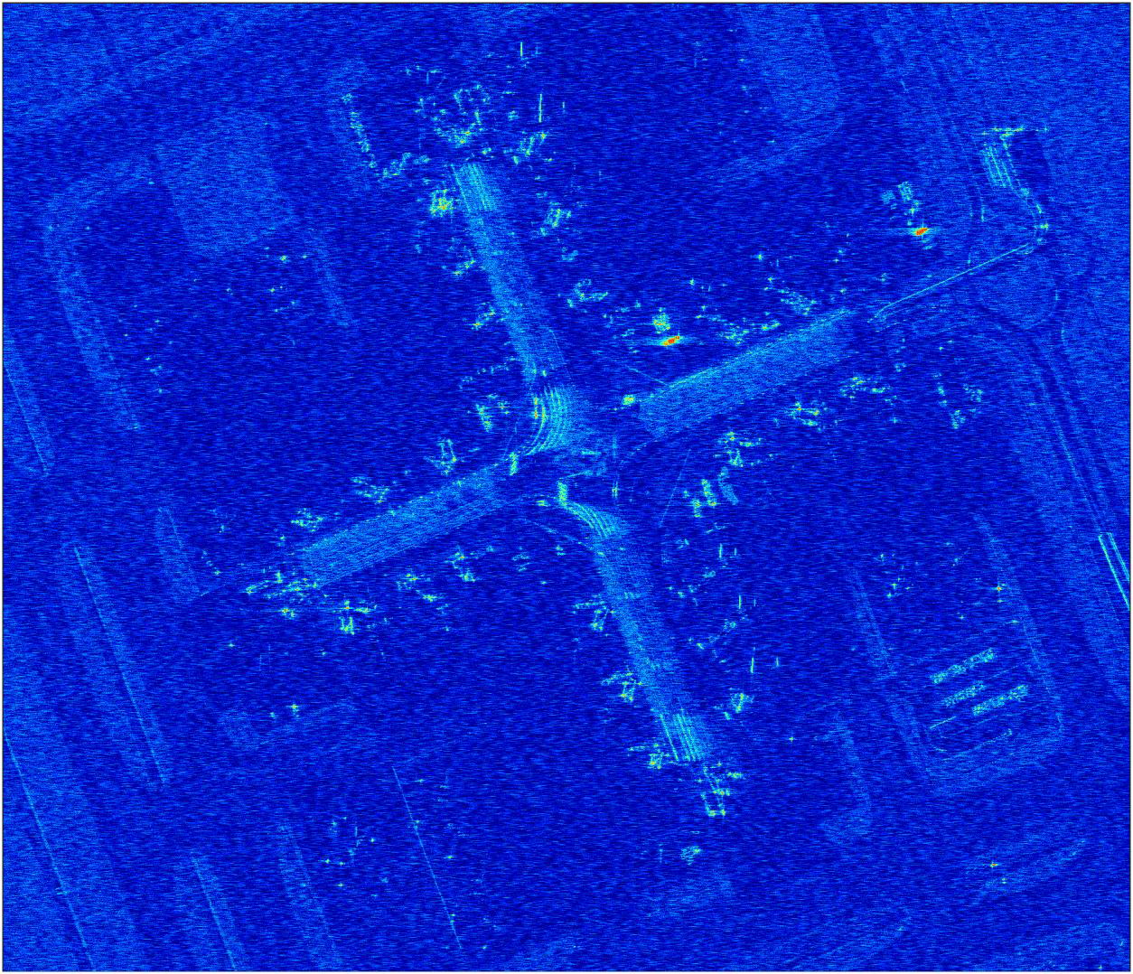
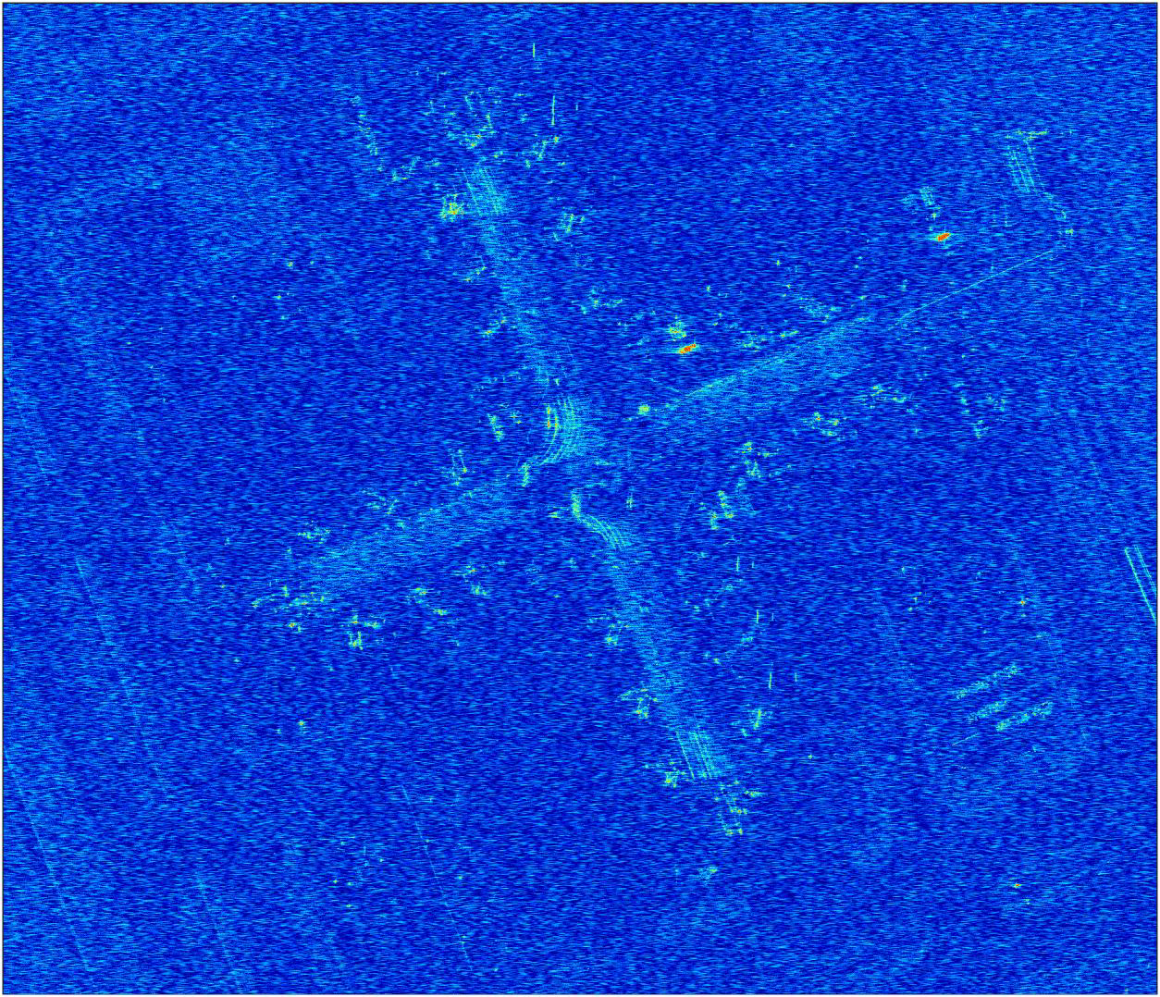
Noise Equivalent Sigma Zero
-18 dB
-15 dB
-10 dB
-5 dB
From: Introduction to Synthetic aperture Radar using Python and Matlab – Andy Harrison - Artech House

Slide 23
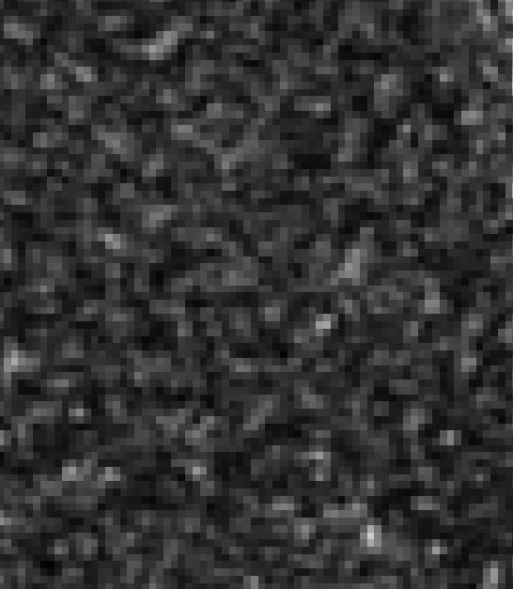

Speckle
Pixels of a SAR image exhibit a high variability in their intensity;
This effect is since in a resolution cell multiple scatterers are contained.

Slide 24
Speckle
For example, if a grass field is illuminated each blade of grass would reflect with similar intensity but with a different phase value.
These returns will interfere constructively and/or destructively creating a salt and pepper effect in the final image.
Sum of returns in pixel 2
Imaginary
Imaginary
Real part
Real part
Sum of returns in pixel 1

Slide 25
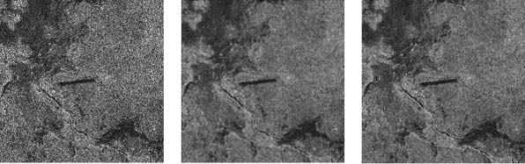
Speckle
Speckle is not noise!
It can be characterized statistically;
It can be mitigated using so called “speckle filters” or multi-look.
Original
Lee Filter
Frost Filter
From: Xiao J., Li J., Moody A. ‘A detail- preserving and flexible adaptive filter for speckle suppression in SAR imagery’. International Journal of Remote Sensing. 2003;24(12):2451–65.

Slide 26
Multi-look
A strategy to mitigate the speckle and at the same time improve the estimation of a target’s reflectivity is to average multiple SAR images;
But how can we do this from a single passage ?
The easier and most popular approach is to split the aperture in L consecutive sub-apertures.
By averaging the L looks the random nature of the speckle is mitigated and the estimate of the target reflectivity improves (Maximum Likelihood estimator).
Whole Synthetic Aperture/Integration Time
Img.1
Img.2
Img.3
Img. L
Split in L consecutive segments to create L images

Slide 27
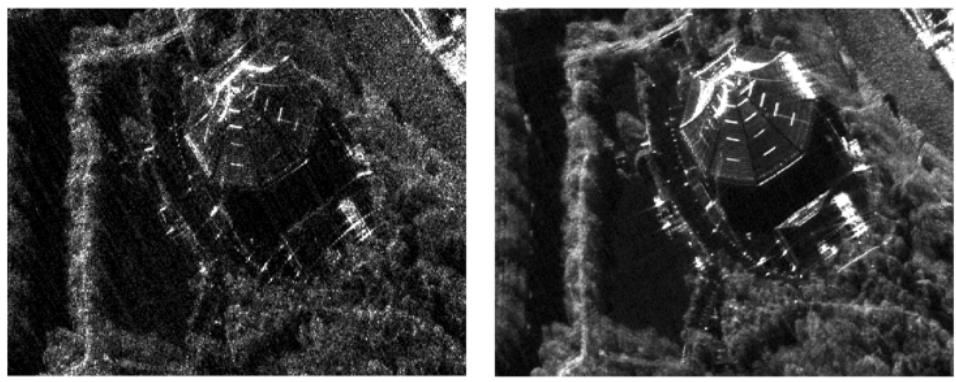
Multi-look
Single Look
Multi-Look – 9 looks
Courtesy of Capella Space

Slide 28
SAR Imaging Modes
SAR can illuminate the scene and therefore acquire data with different configurations;
A SAR sensor can be configured with different operation modes, depending on the task;
Various configurations are suitable for different applications and elaborations of the SAR data;
Example of the acquisition modes are:
Stripmap
Spotlight
ScanSAR
TOPSAR
Other modes exist (also combining the above) but these 4 are the most frequently used.

Slide 29
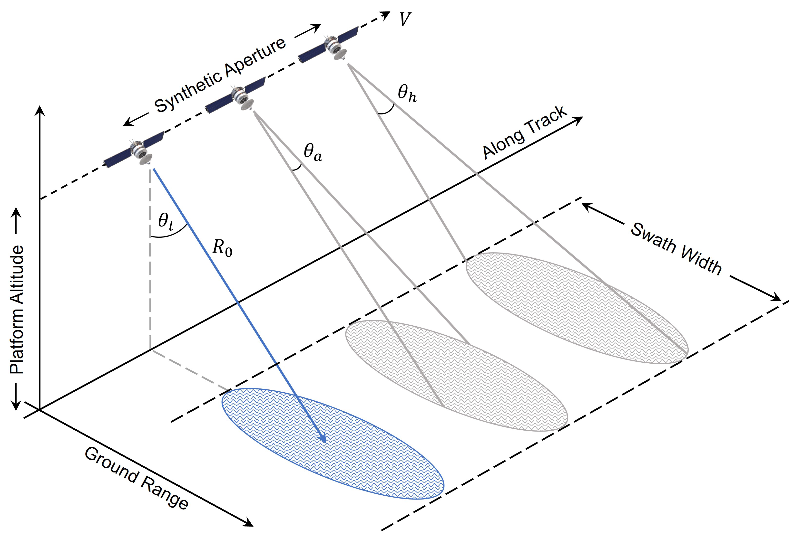
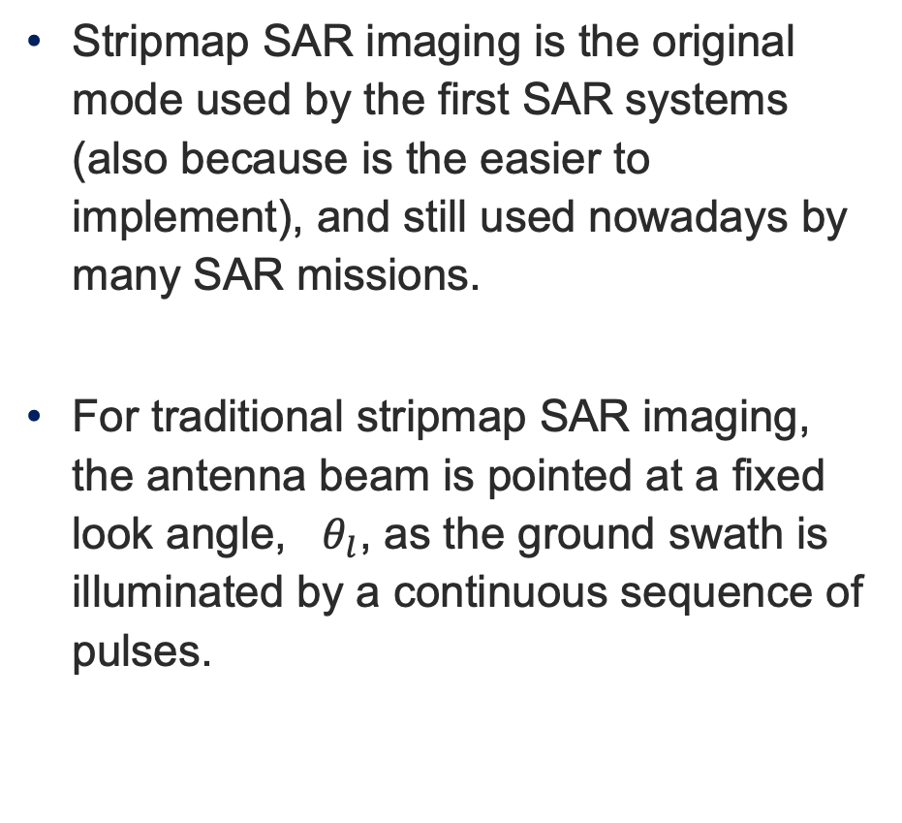
Stripmap
Stripmap SAR imaging is the original mode used by the first SAR systems (also because is the easier to implement), and still used nowadays by many SAR missions.
For traditional stripmap SAR imaging, the antenna beam is pointed at a fixed look angle, $θ_{l}$, as the ground swath is illuminated by a continuous sequence of pulses.
Image From: Introduction to Synthetic aperture Radar using Python and Matlab – Andy Harrison - Artech House

Slide 30
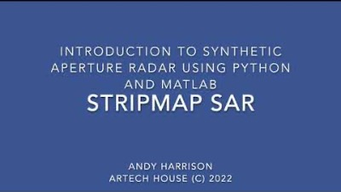
Stripmap
From: Introduction to Synthetic aperture Radar using Python and Matlab – Andy Harrison - Artech House

Slide 31
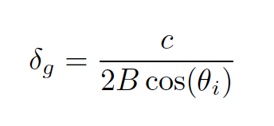
Stripmap
The ground range resolution (the projection on the ground of the range resolution) is:
While the azimuth resolution is half the physical size of the antenna in the azimuth direction (as derived previously).

Slide 32
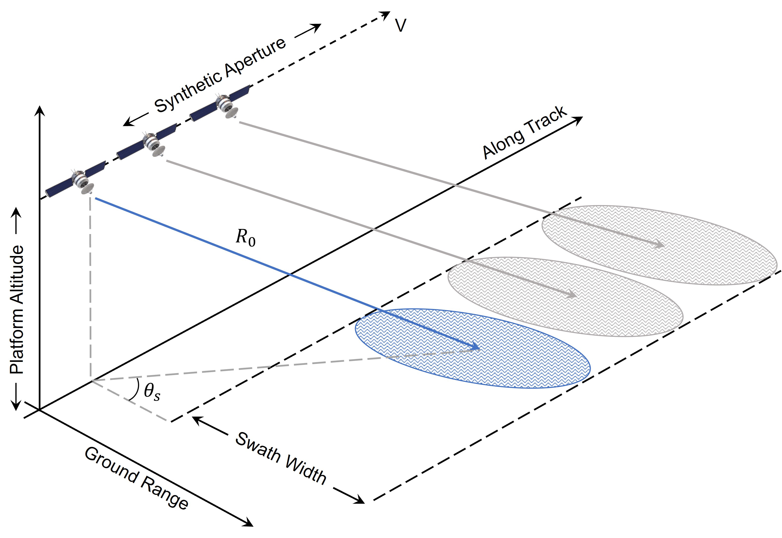
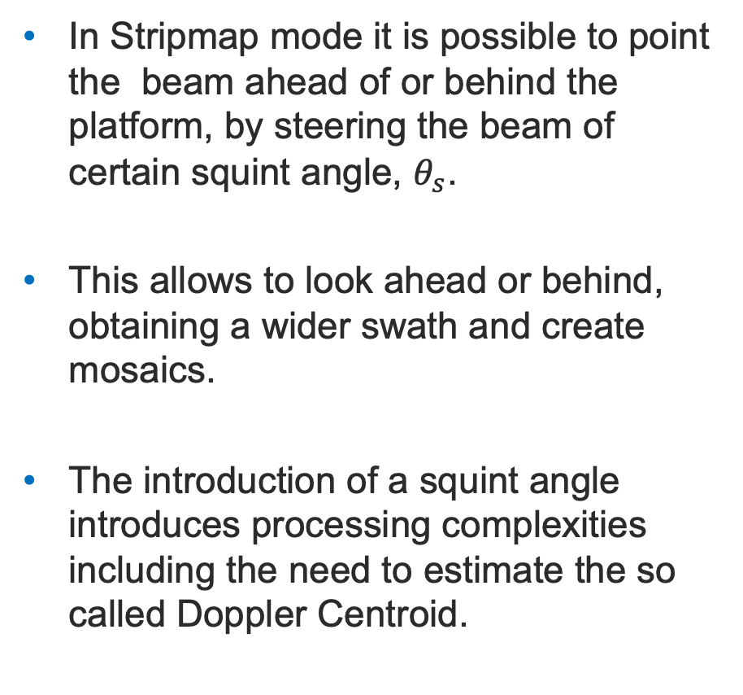
Stripmap
In Stripmap mode it is possible to point the beam ahead of or behind the platform, by steering the beam of certain squint angle, $θ_{s}$.
This allows to look ahead or behind, obtaining a wider swath and create mosaics.
The introduction of a squint angle introduces processing complexities including the need to estimate the so called Doppler Centroid.
Image From: Introduction to Synthetic aperture Radar using Python and Matlab – Andy Harrison - Artech House

Slide 33
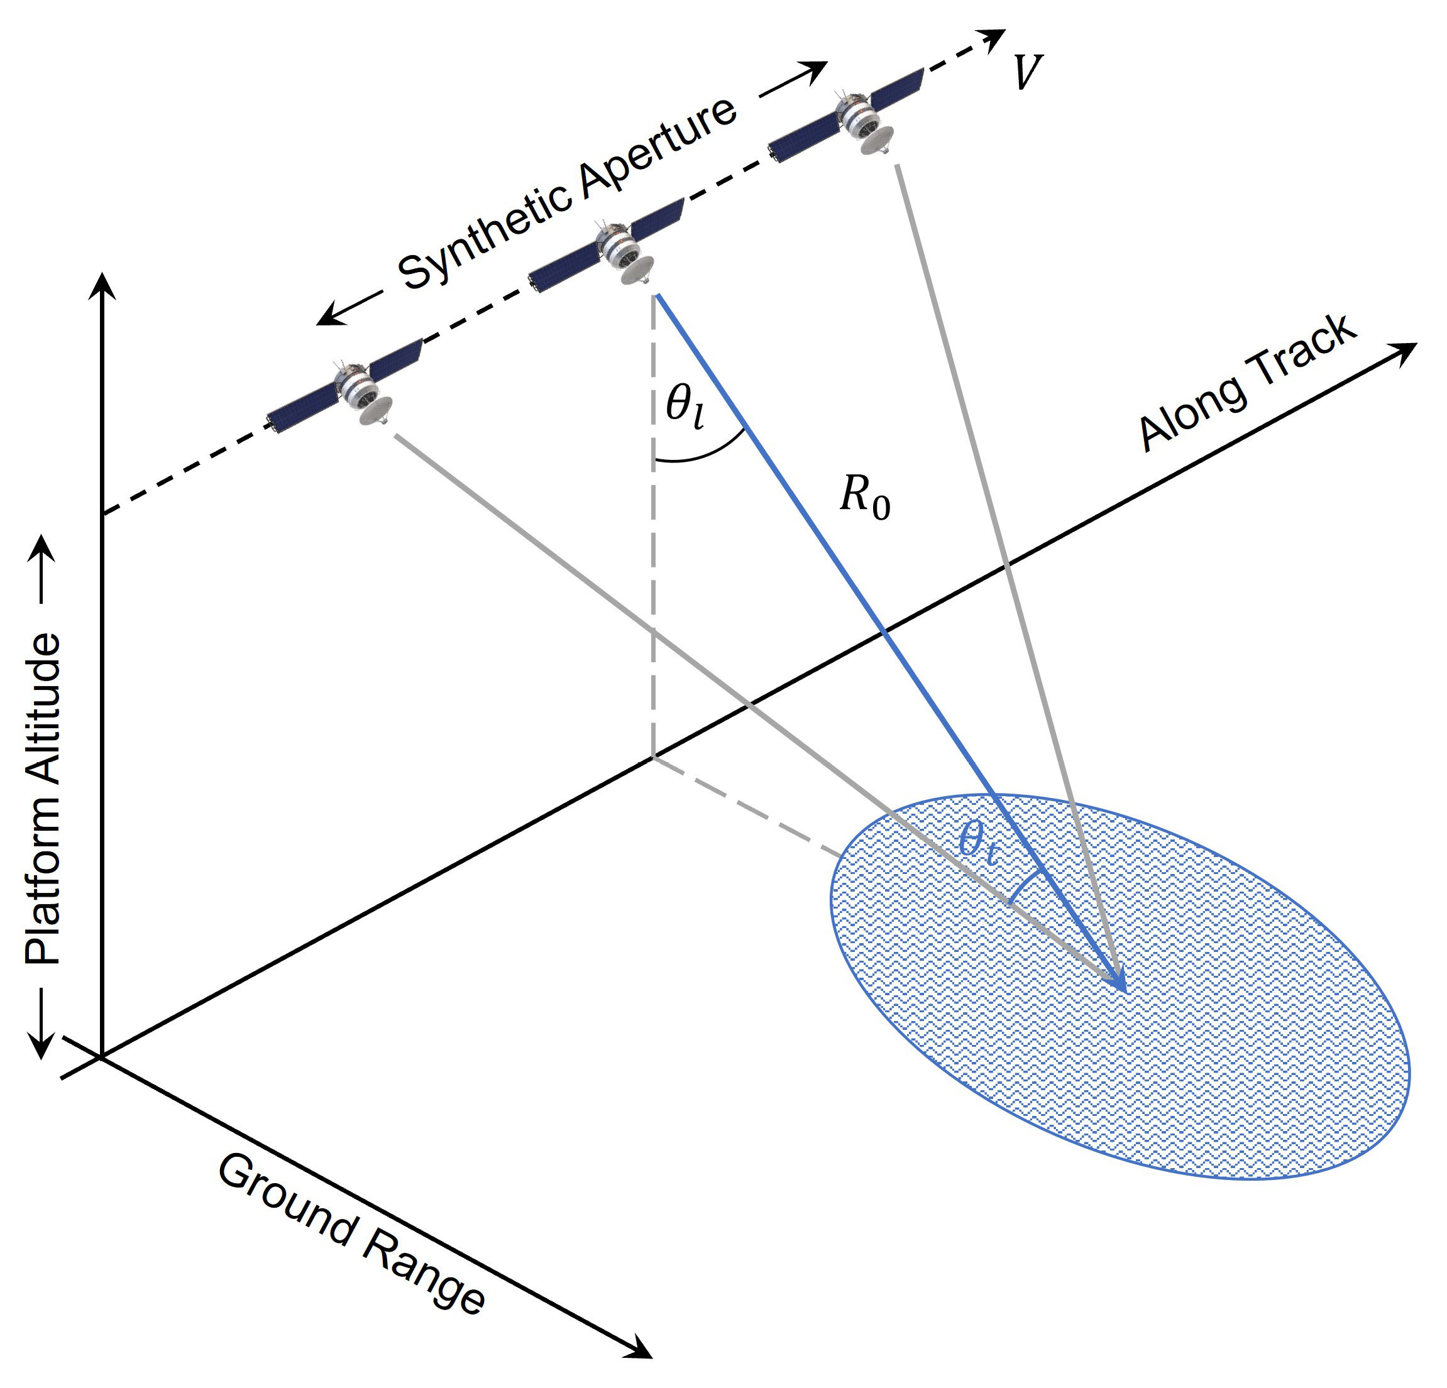
Spotlight
Spotlight SAR uses mechanical or electronic beam steering to keep the target area illuminated for a longer period;
This reduces the scene size, but at the same time ensures that the scene is illuminated for a longer time, producing finer resolution images
Image From: Introduction to Synthetic aperture Radar using Python and Matlab – Andy Harrison - Artech House

Slide 34
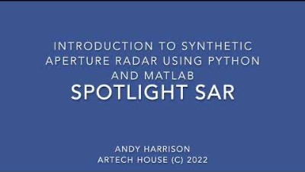
Spotlight
From: Introduction to Synthetic aperture Radar using Python and Matlab – Andy Harrison - Artech House

Slide 35
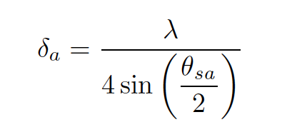
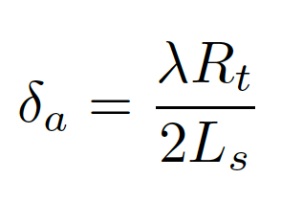
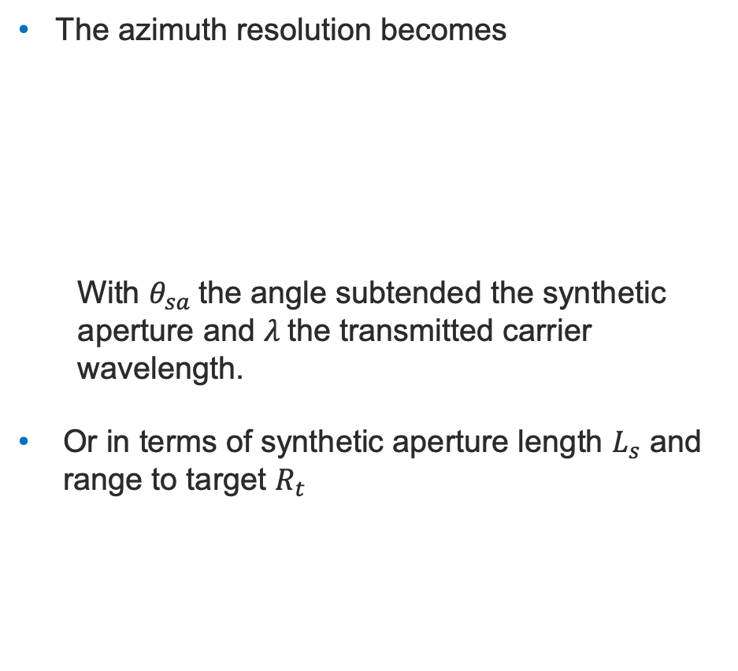
Spotlight
The azimuth resolution becomes
With $θ_{sa}$the angle subtended the synthetic aperture and $λ$the transmitted carrier wavelength.
Or in terms of synthetic aperture length $L_{s}$ and range to target $R_{t}$
Image From: Introduction to Synthetic aperture Radar using Python and Matlab – Andy Harrison - Artech House

Slide 36
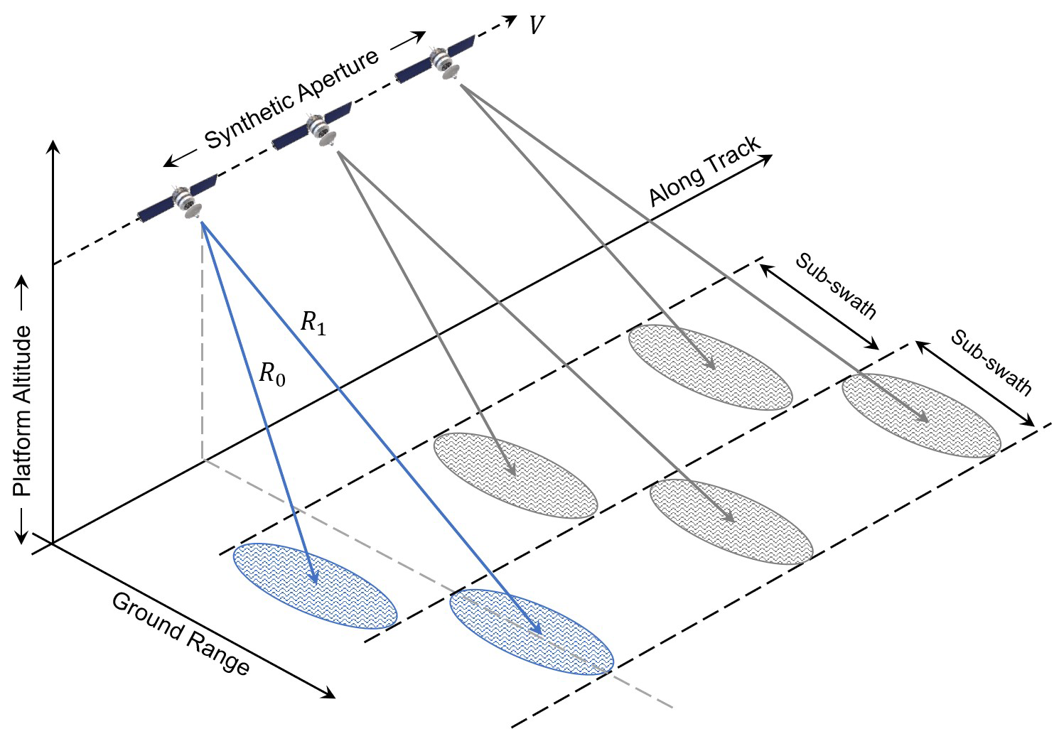
ScanSAR
This mode is used to image large areas by increasing the swath width;
The width is increased by scanning the beam in elevation, in 2 or more sub-swaths;
This means that an area is illuminated for less time compared to Stripmap mode, leading to poorer resolution and lower SNR.
Image From: Introduction to Synthetic aperture Radar using Python and Matlab – Andy Harrison - Artech House

Slide 37
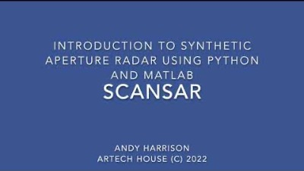
ScanSAR
From: Introduction to Synthetic aperture Radar using Python and Matlab – Andy Harrison - Artech House

Slide 38
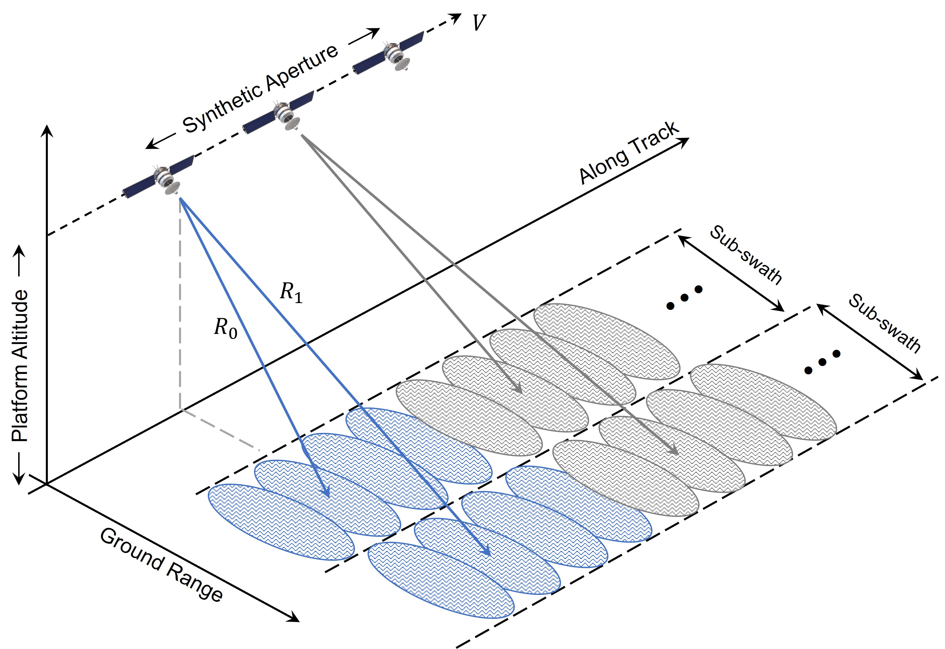
TOPSAR
Terrain observation by progressive scan (TOPSAR) is similar to ScanSAR, with the difference that the beam scans also in Azimuth.
Compared to ScanSAR this mode produce more consistent imaging and uniform SNR.
Image From: Introduction to Synthetic aperture Radar using Python and Matlab – Andy Harrison - Artech House

Slide 39
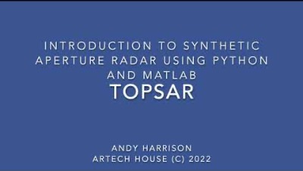
TOPSAR
From: Introduction to Synthetic aperture Radar using Python and Matlab – Andy Harrison - Artech House

Slide 40
SAR Processing
Dr Carmine Clemente
carmine.clemente@strath.ac.uk
Original SAR image courtesy of Capella Space

Slide 41
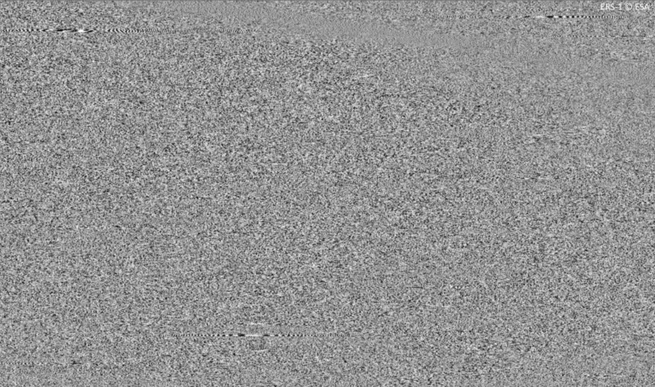
SAR Image Formation
The data (I/Q) recorded by the sensor are not the final image, indeed they are very different!
This is because for each PRI the echoes from the entire 2D scene are recorded in a 1D signal…but the scene is observed from a slightly different angle (or with a different Doppler)

Slide 42
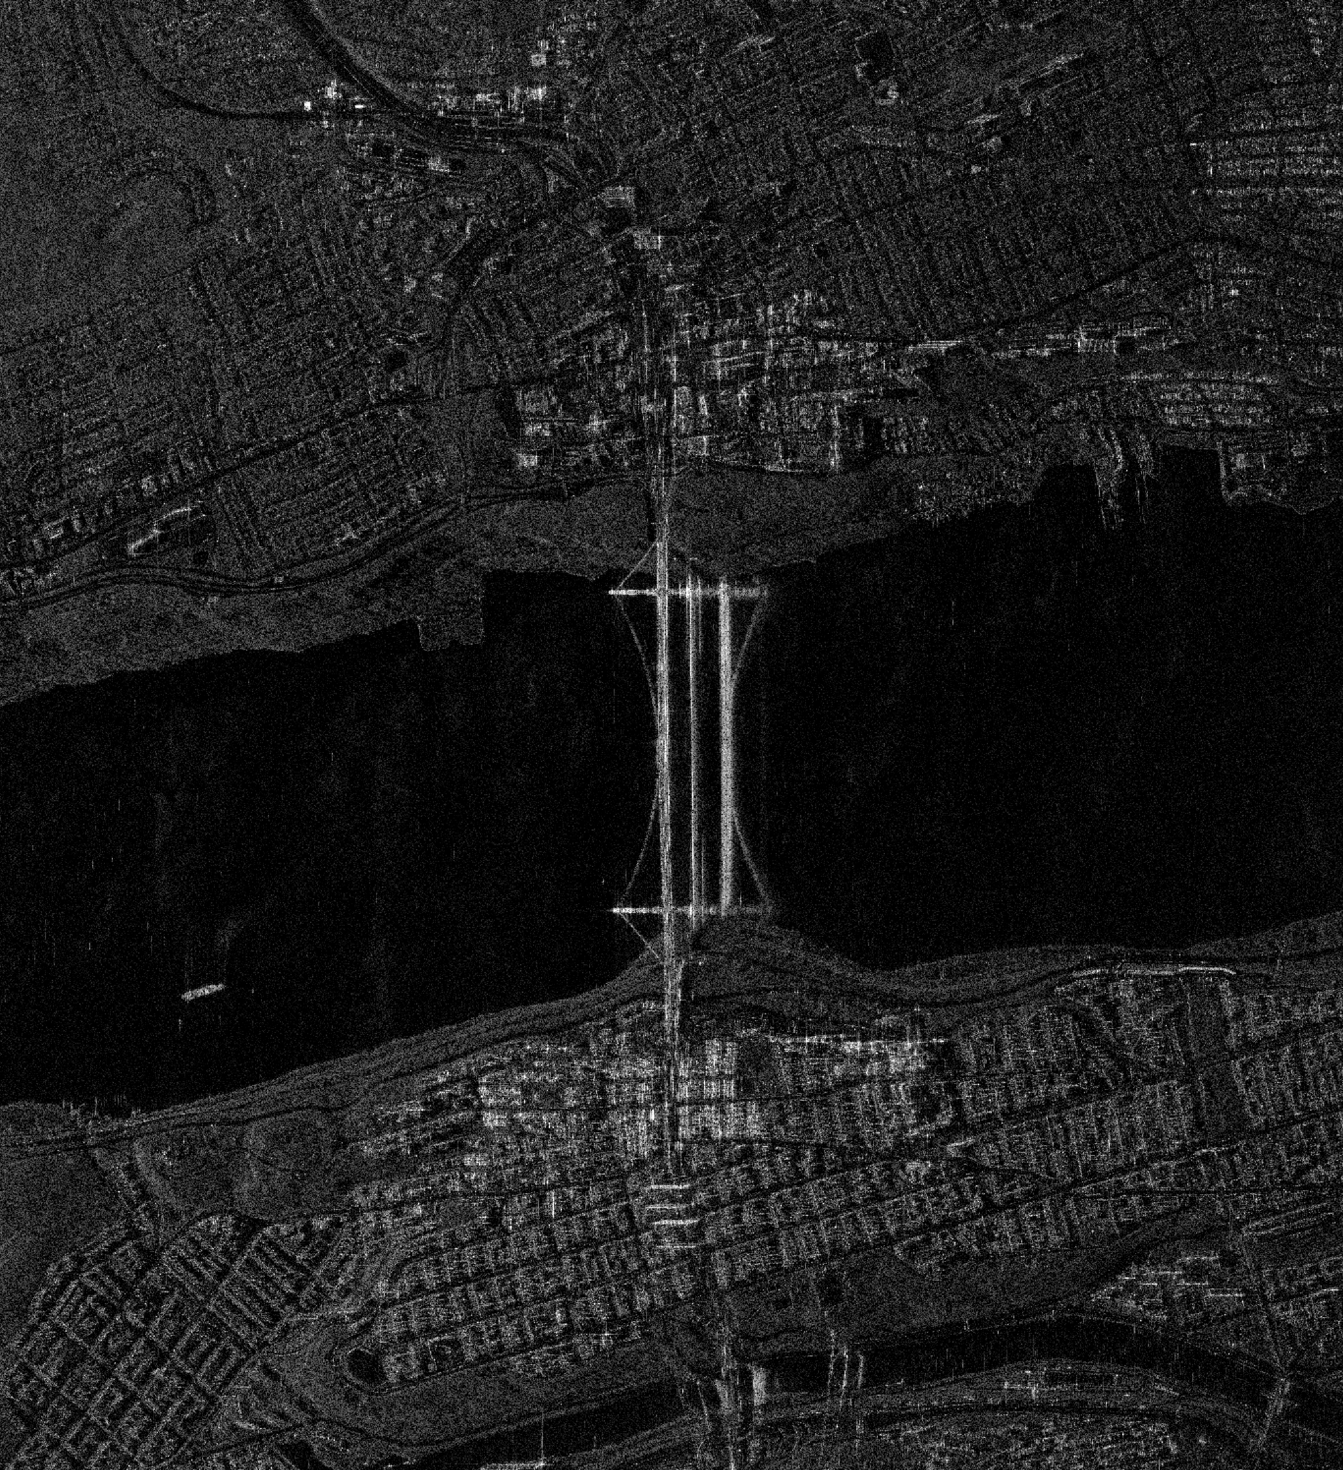
SAR Image Formation
Signal Processing

Slide 43

Image formation algorithms
The image formation process is a computationally intense processing;
In early days optical lens and films based processing methods were used;
Nowadays there are a number of digital signal processing algorithms developed that solve the imaging problem:
Range Doppler
Chirp Scaling
Backprojection
Polar format
…
To address the computational demand, hardware with High Performance Computing such as GPUs are used on the ground to form the images;
In same cases the image is also formed on board of airborne platforms and in the future it is likely to see images created on board of satellites.

Slide 44
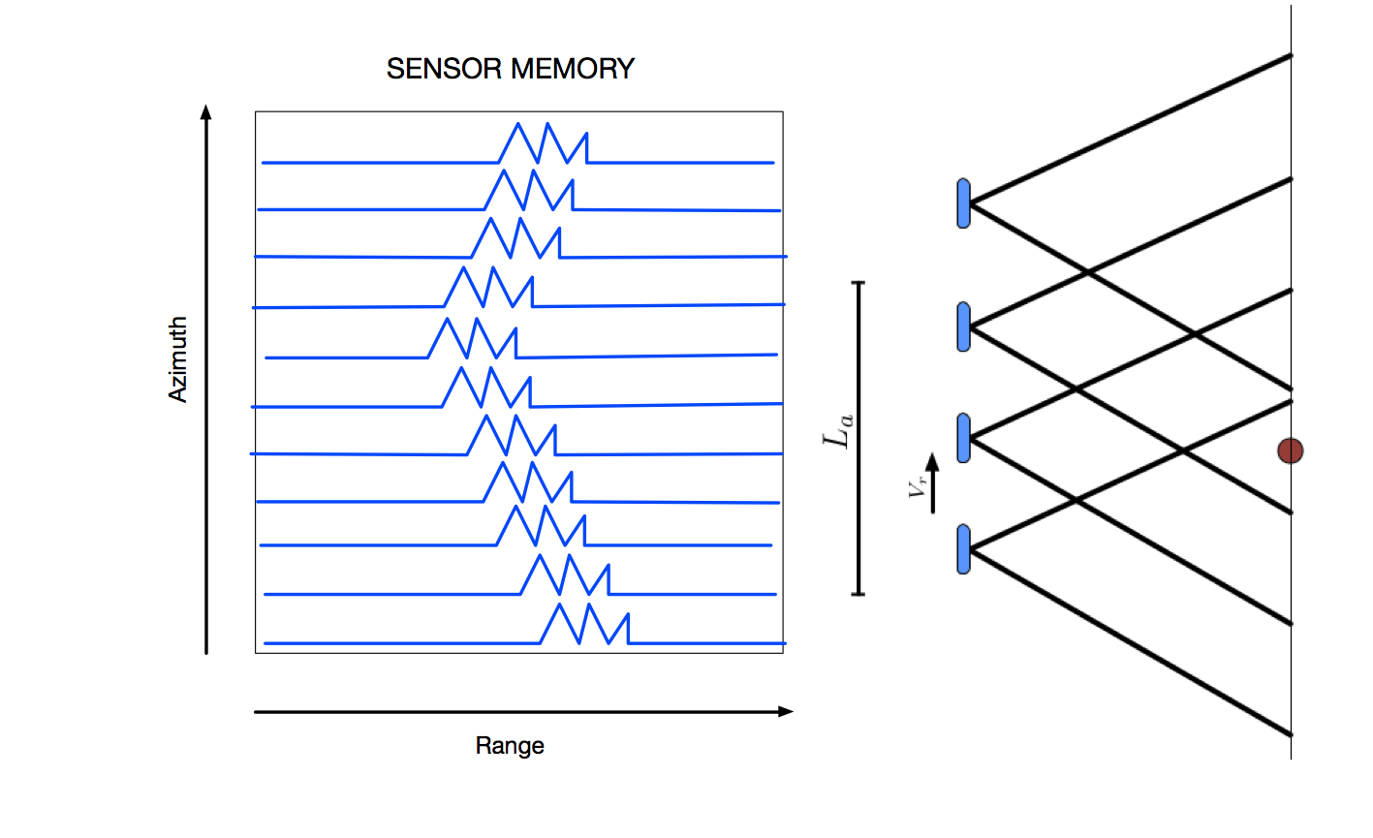
Range Cell Migration
Before looking at the processing steps, let’s make a consideration about the expected position in range of a target;
As the platform moves along the aperture, the range between the platform and a generic target will vary, creating the so-called Range Cell Migration;
This is a factor that needs to be considered and corrected when forming the final image.

Slide 45
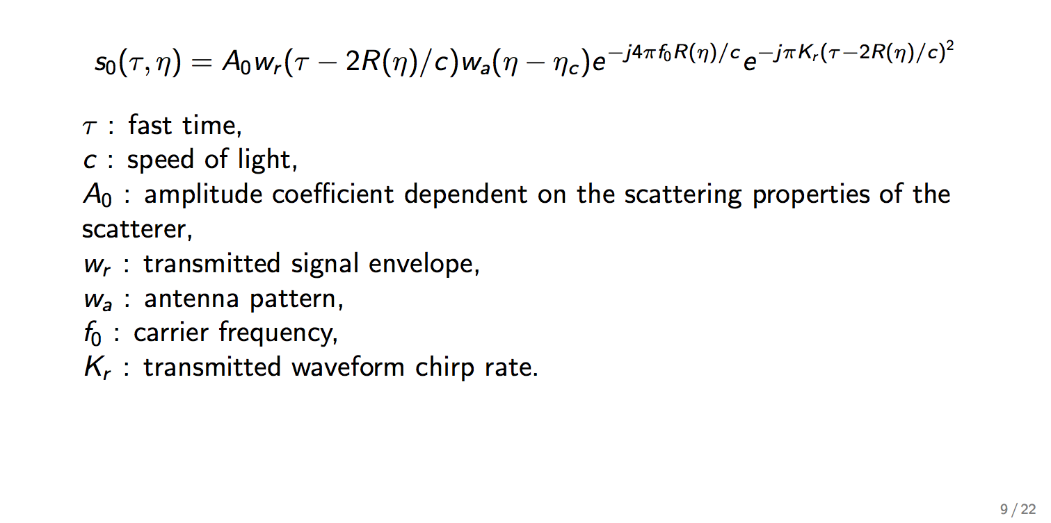
SAR Demodulated Baseband Signal
To understand how to create the image, we need to understand what the recorded signal looks like

Slide 46
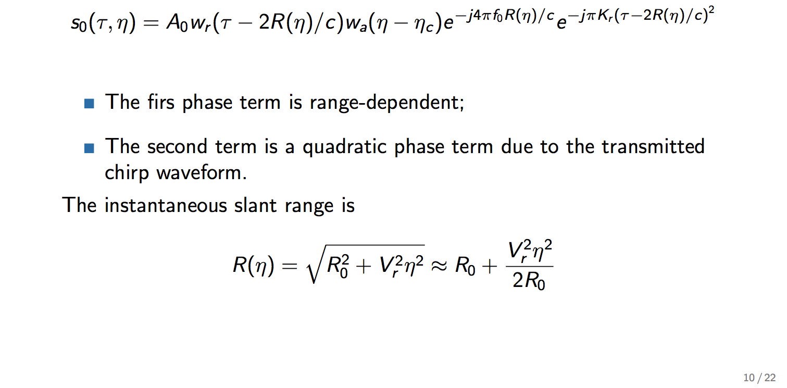
SAR Demodulated Baseband Signal
t

Slide 47

SAR Signal Spectrum

Slide 48

SAR Signal Spectrum

Slide 49

Range-Doppler Spectrum

Slide 50
Range-Doppler Algorithm
Is one of the most widely used, developed in 1979 to process SEASAT data;
Separates Range and Azimuth compression, thus allowing to integrate further operations such as Range Cell Migration Correction;
Makes a large use of Fast Fourier Transform, making the algorithm computationally efficient.

Slide 51
Range-Doppler Algorithm
Range compression
Range FFT
Azimuth FFT
Data in the Range-Doppler Domain
RCMC
Interpolation or phase compensation
Range Matched filter
Range IFFT
Azimuth Compression
Azimuth Matched Filter
Azimuth IFFT
Focused Image
Brings the data back in the 2D range/cross-range domain

Slide 52

Range-Doppler Algorithm – Range Compression

Slide 53


Range-Doppler Algorithm – Range Compression

Slide 54

Range-Doppler Algorithm – Azimuth FFT

Slide 55

Range-Doppler Algorithm – Azimuth FFT

Slide 56

Range-Doppler Algorithm – Range Cell Migration Correction

Slide 57

Range-Doppler Algorithm – Range Cell Migration Correction

Slide 58

Range-Doppler Algorithm – Range Cell Migration Correction
In the Range-Azimuth domain…

Slide 59

Range-Doppler Algorithm – Azimuth Matched Filter

Slide 60

Range-Doppler Algorithm – Azimuth Matched Filter and IFFT

Slide 61

Range-Doppler Algorithm – Azimuth Matched Filter and IFFT

Slide 62
X THE PLACE OF USEFUL LEARNING

